Slide 1
Concert Booking System
Noah Bowman, Pranjal Ghimire, Jae Choi, Fernando Clark del Valle, Julian Jeong, Reya Dawlah, Rohit Nair

Slide 2
Table of contents
01
02
03
Objective
Cost Estimation
Project Timeline
04
05
06
Requirements
Diagrams
Architectural Design

Slide 3
Objective
Building a system that allows fans of an artist/band to reserve tickets at a concert and suggest songs that the artist/band could perform at the concert

Slide 4
Cost Estimation
The salary for a web developer internship in Dallas, TX is $79,316 per year or $38 per hour.
Since we have 7 members, the personnel cost will be about $555k per year.

Slide 5
Project Timeline
Deliverable 1
Deliverable 2
Team Formation
Initial Discussion
Final deliverable was submitted
01
02
03
04
05
Model Selection cost and time estimation
Initial Planning
Presentation
Team Formation
Initial Discussion
The final team presentation
Getting things ready for Deliverable 2

Slide 6
Project Timeline
 | Task 1 | Task 2 | Task 3 | Task 4 | Task 5
Description | Task Delegation, Initial working | Methodology selection | Deliverable 1 | Cost Estimation, Design | Presentation Preparation
Start Date | August 31 | September 13 | October 20 | November 7 | Upcoming
Duration | 4 week | 5 week | 3 weeks | 2 weeks | TBD

Slide 7
Functional Requirements
View all upcoming concert dates
Open form to reserve a ticket
While buying a ticket, select up to 3 song preferences for performance
Refund ticket if bought within 24 hours
Allow artists to create concerts

Slide 8
Nonfunctional Requirements
Usability
The UI should be interactive and also have accessibility settings so that everyone can use the application.
Performance
The application should load within 3 seconds for up to 50 users at any instance.
Space
The website would be at most 3 mb of storage.
Dependability
The percentage of failure shouldn’t exceed 10% of use cases.
Security
The information provided by the customer will not be sold and be used only for intended purpose.
Environmental
The application runs 24/7 and requires a stable internet connection to function.

Slide 9
Nonfunctional Requirements
7. Operational
It runs on chromium based web browsers such as Google Chrome and Microsoft Edge.
8. Development
Safe coding practices should be followed when developing the code along with common agile practices. The program development will use Git as a version control system.
9. Regulatory
The application should follow WCAG accessibility standards.
10. Ethical
The application should provide transparency about user data sharing, licensing, and privacy policy.
11. Accounting
The project cost should be budgeted according to General Accepted Accounting Principles (GAAP). Purchases will be limited to the U.S only.
12. Safety/security - Warning should be provided for age restricted
concerts before ticket purchase.

Slide 10
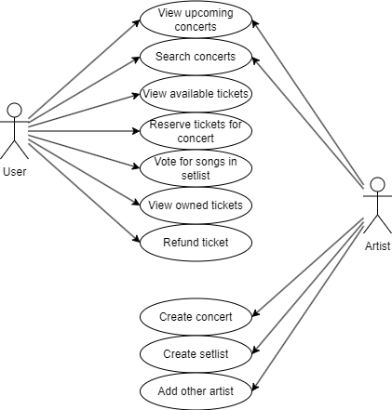
Use Case Diagram

Slide 11
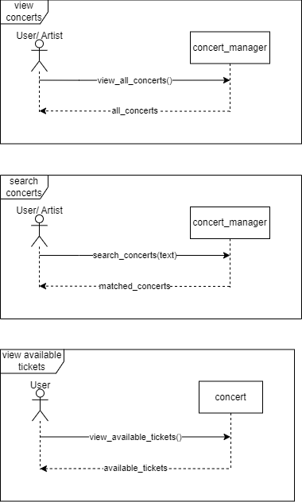
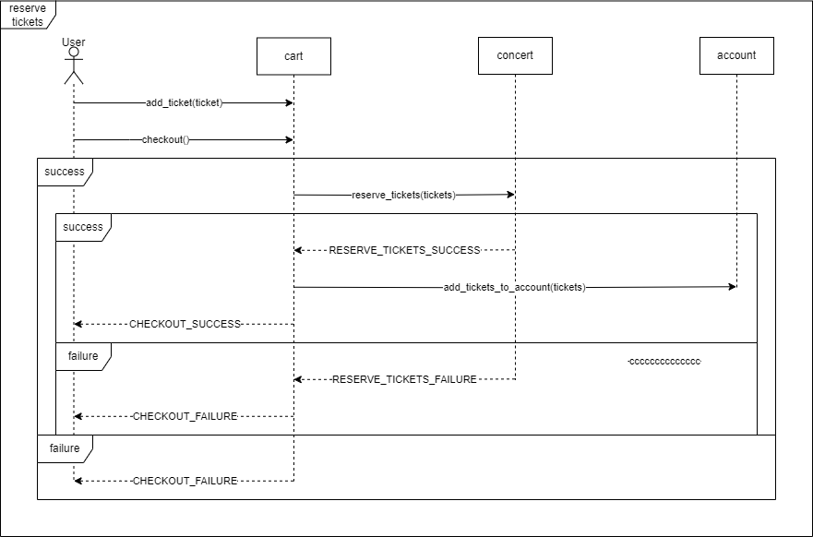
Sequence Diagrams

Slide 12
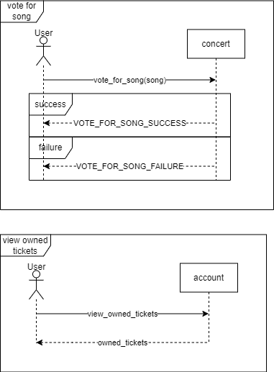
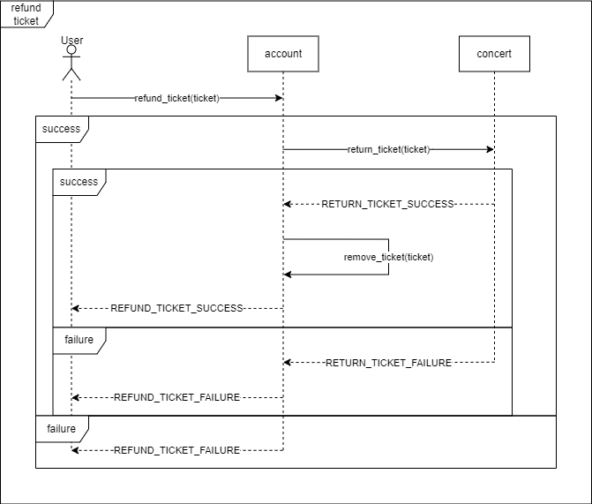

Slide 13
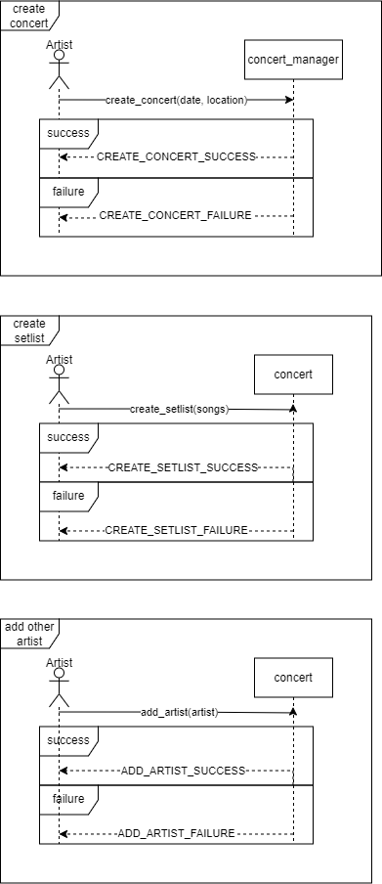

Slide 14
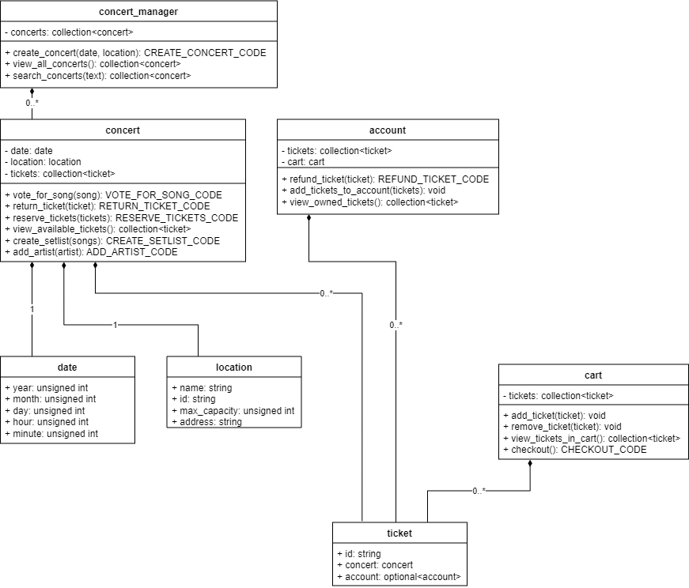
Class Diagram

Slide 15
Architectural Design
We agreed to use the MVC pattern because you can separate the front end, middle, and backend into three separate pieces
This will allow us to separate the logic and work on each part independently, making it easier for each group member to develop separate parts of the program concurrently

Slide 16
